Slide 1

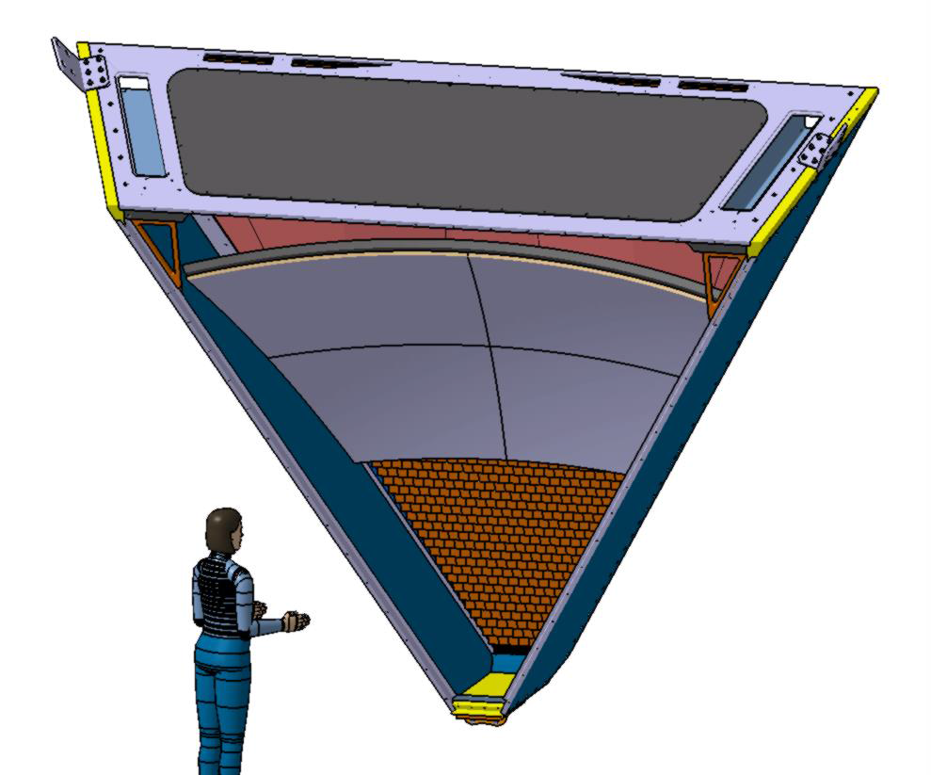

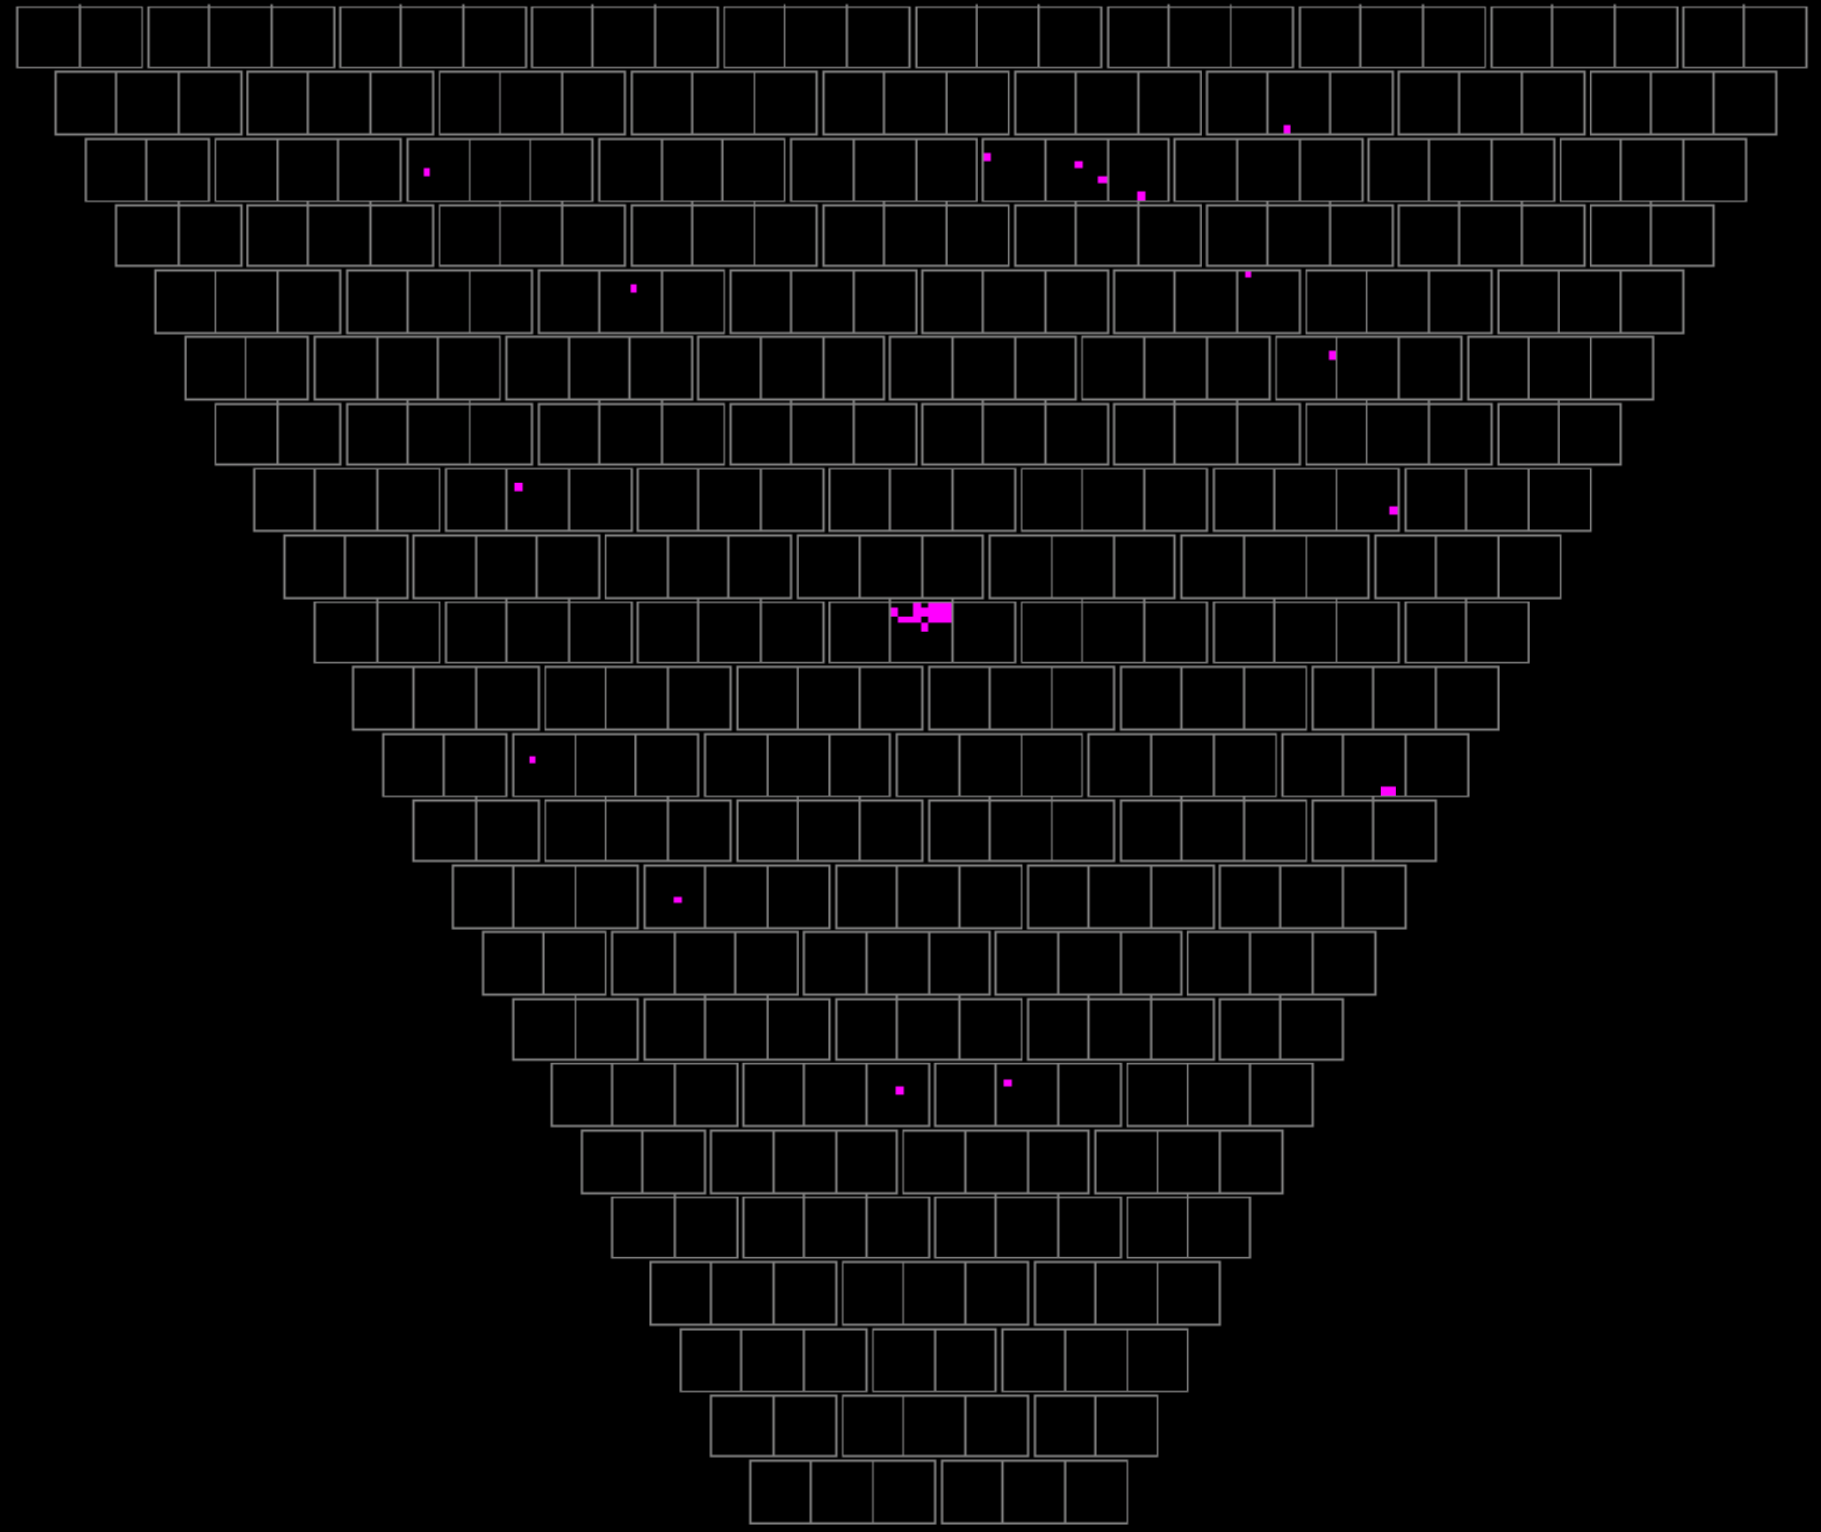
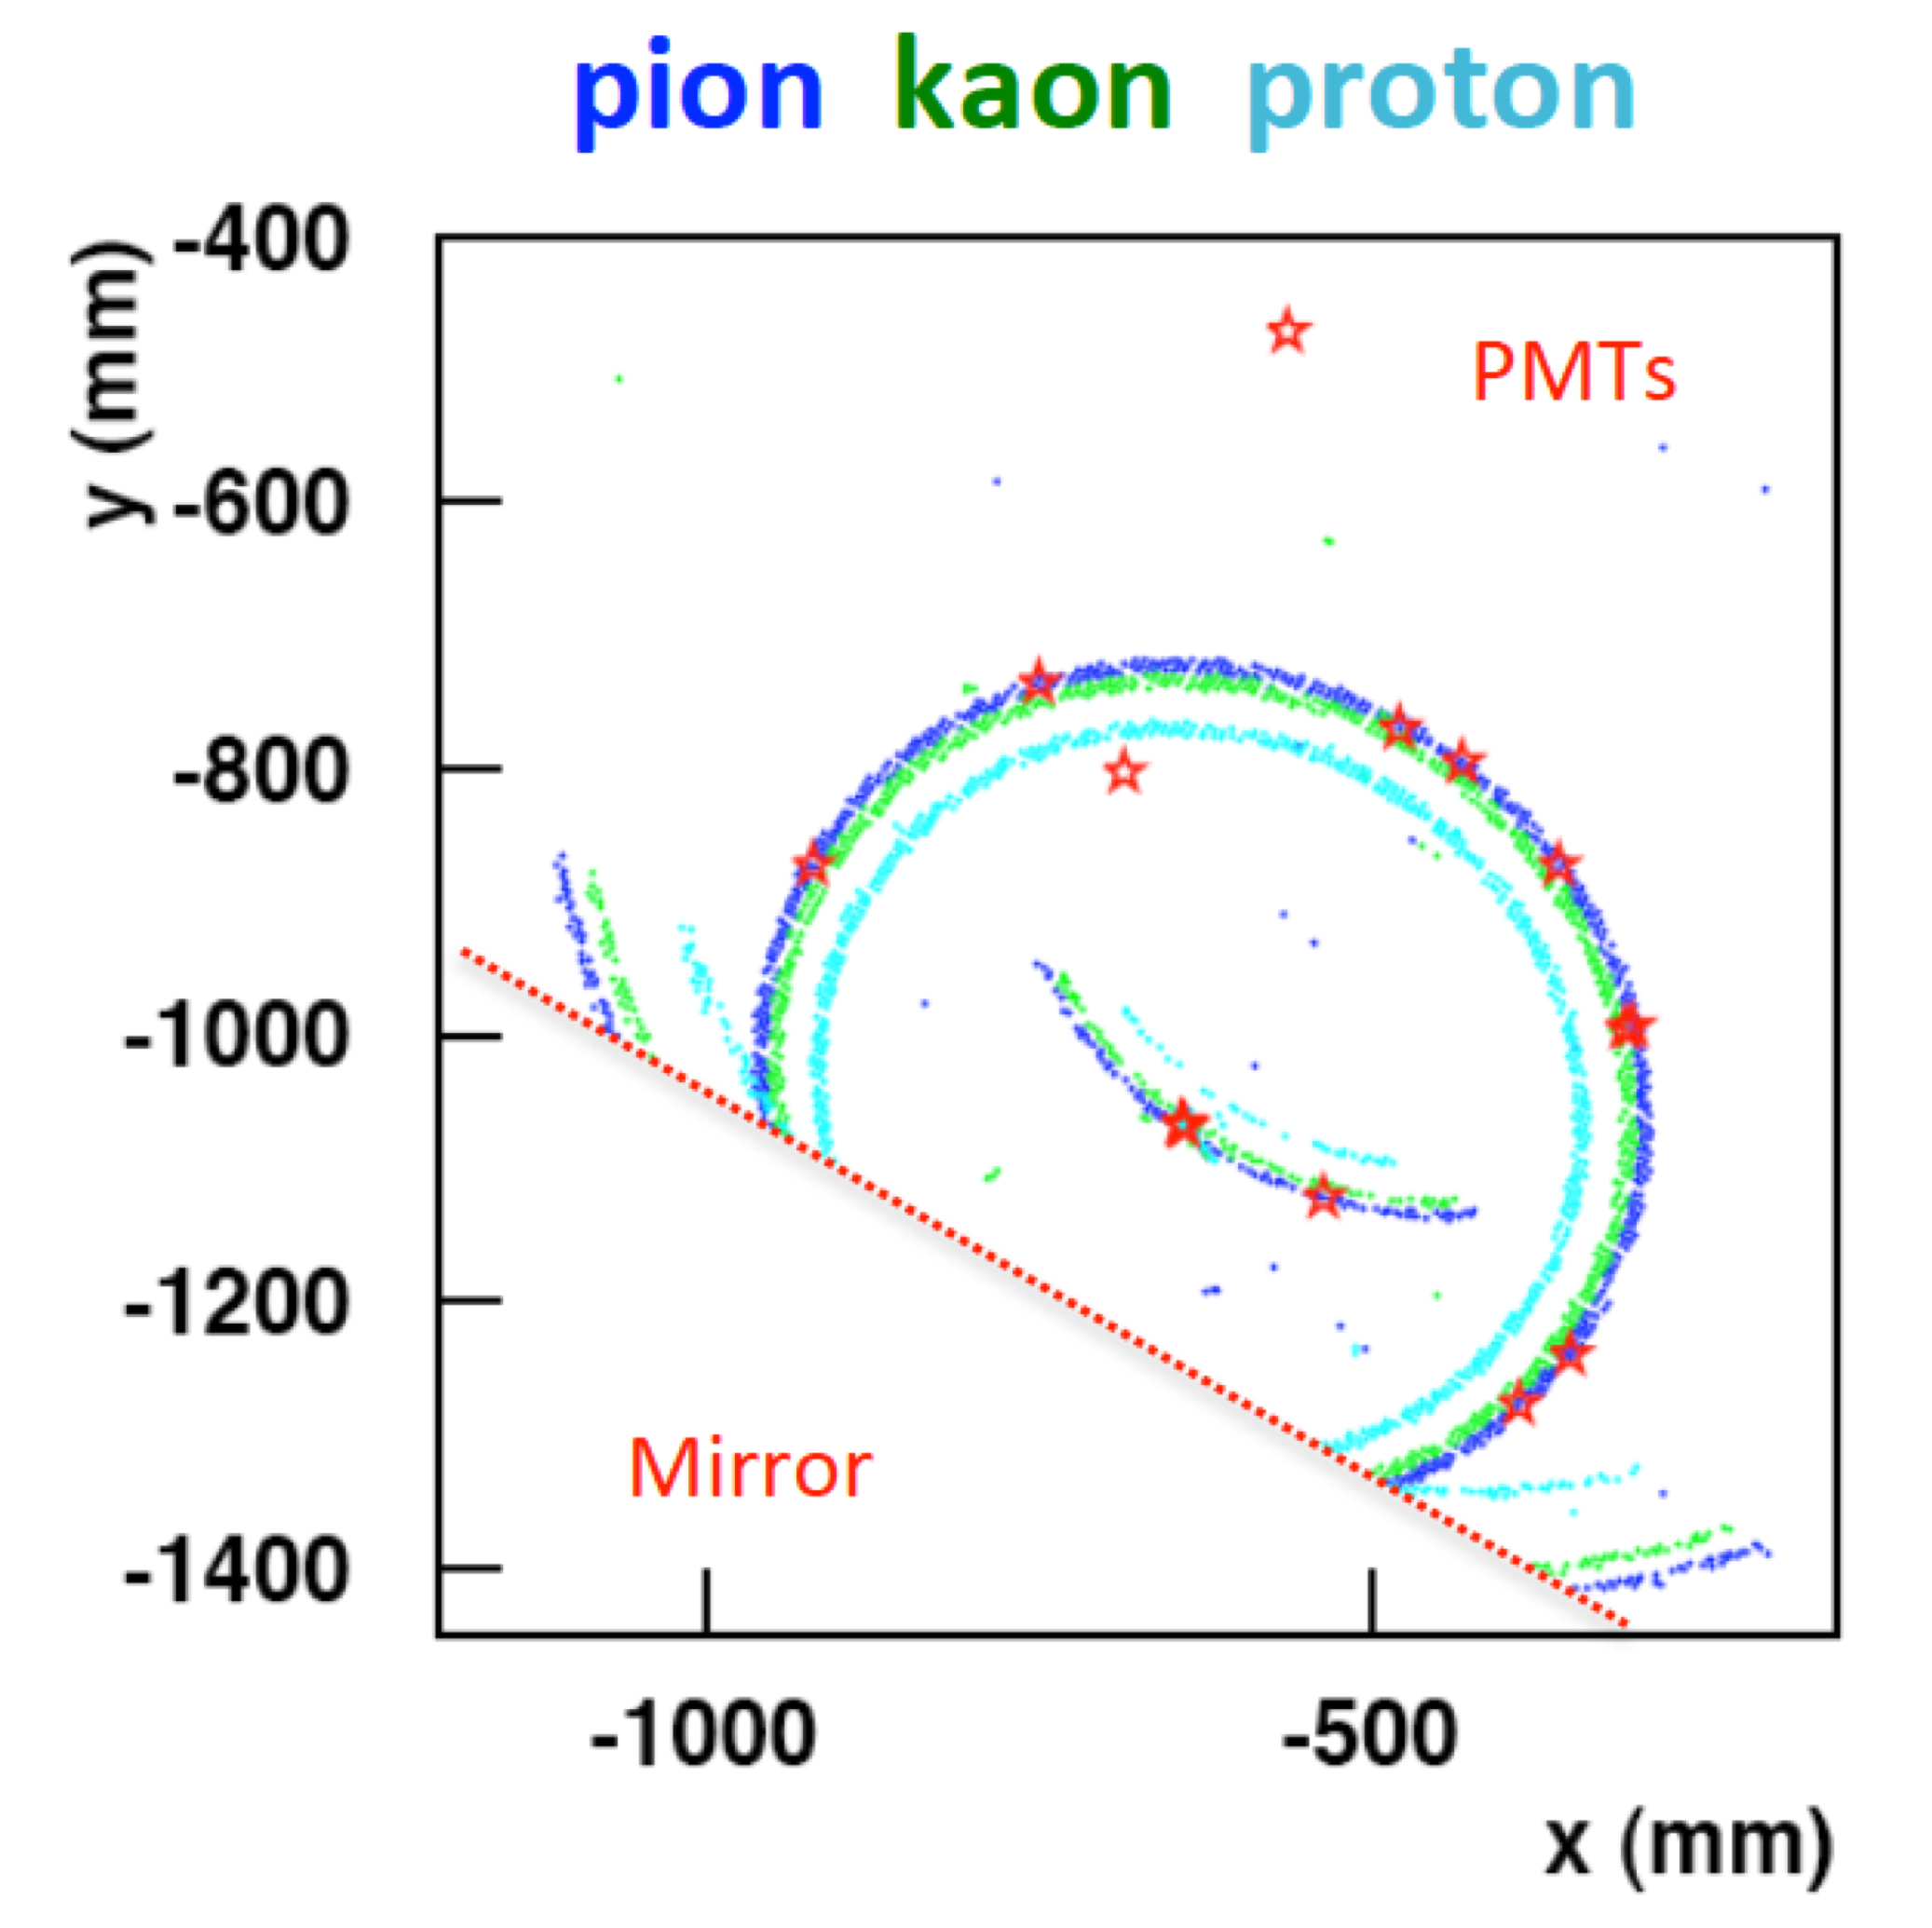
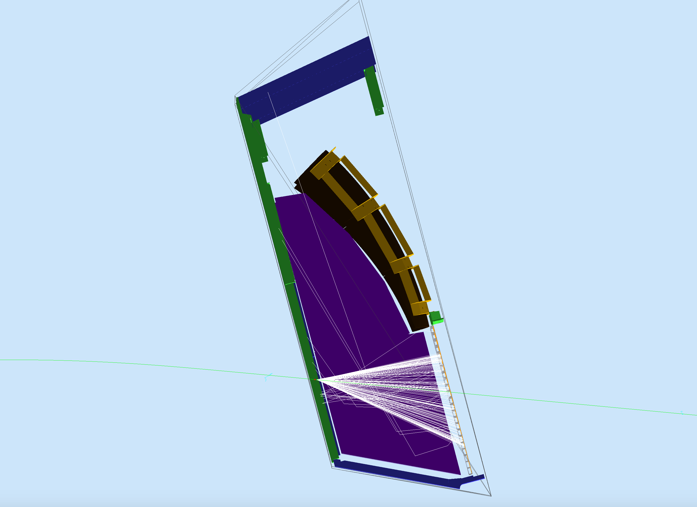
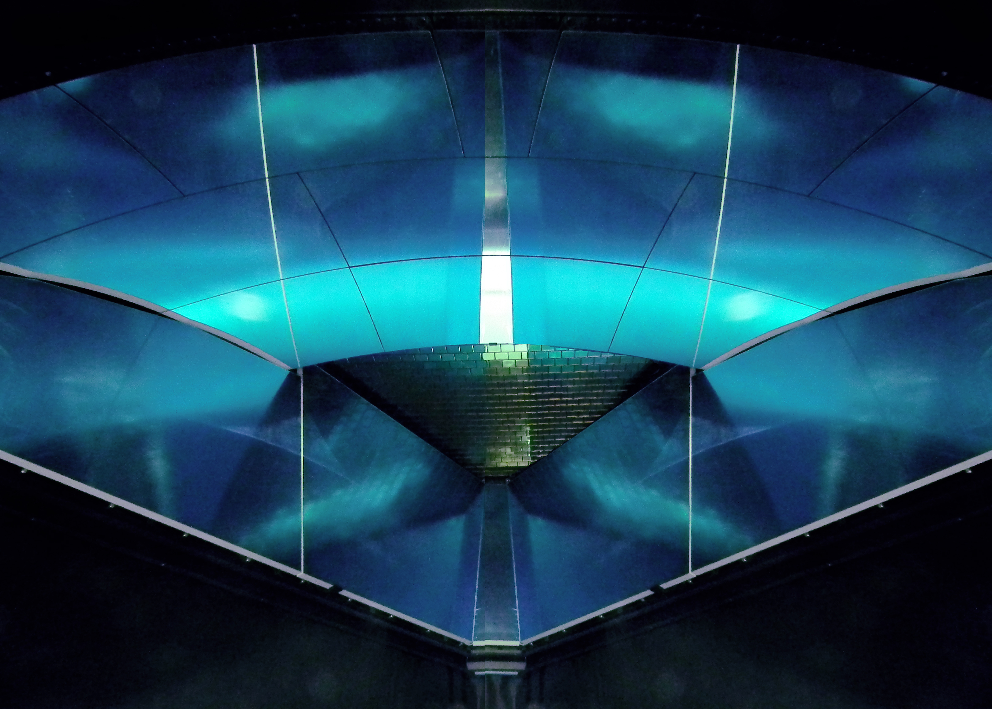
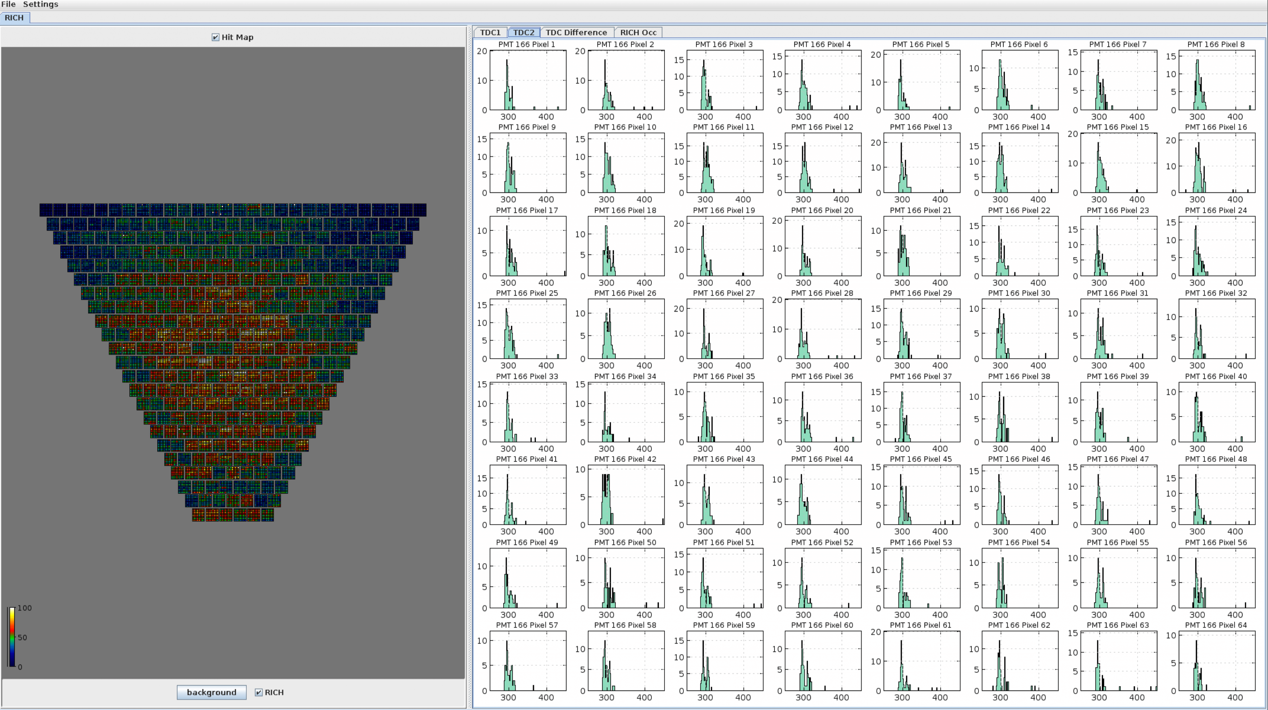
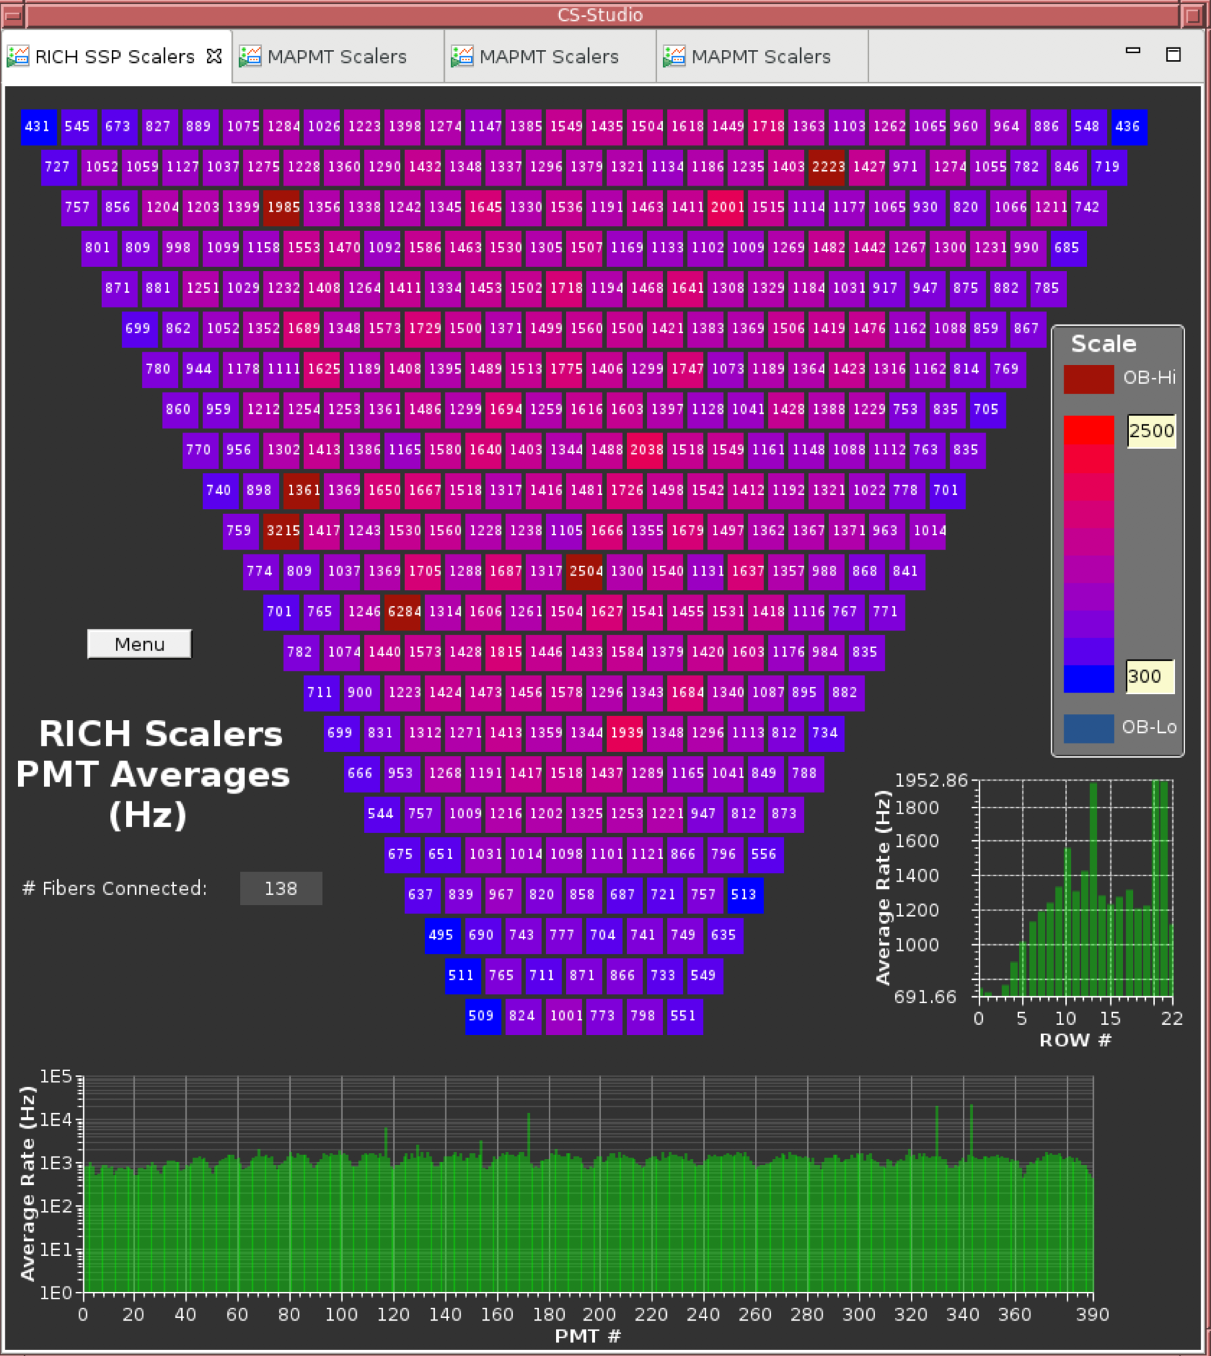
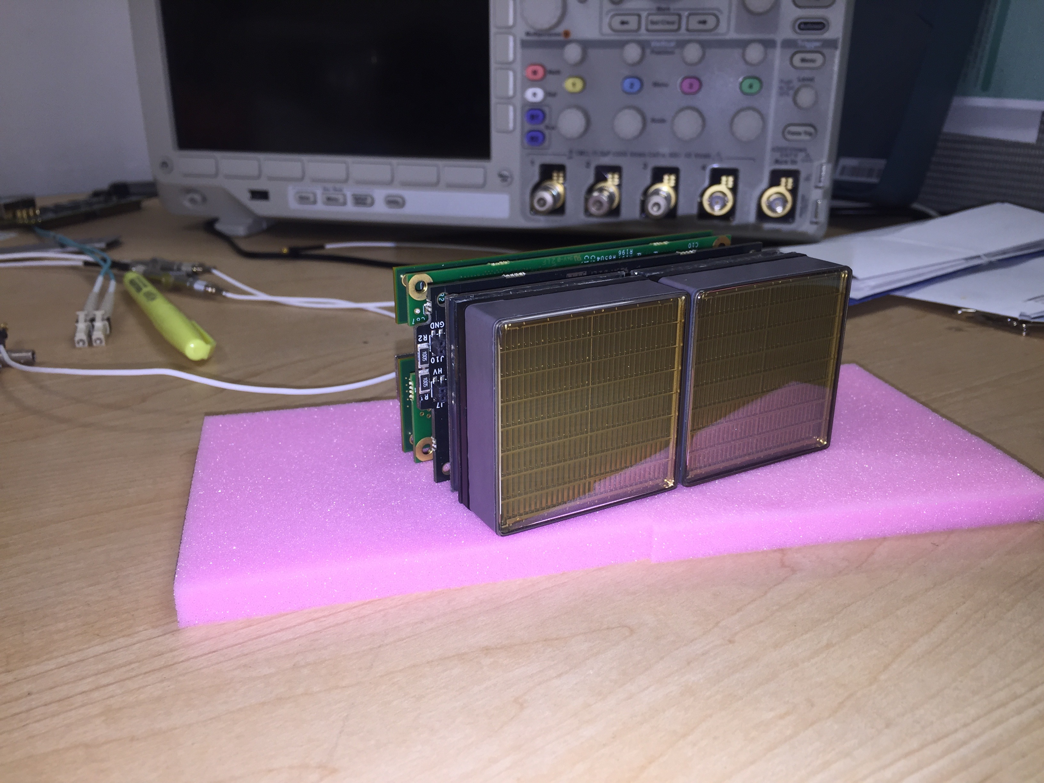
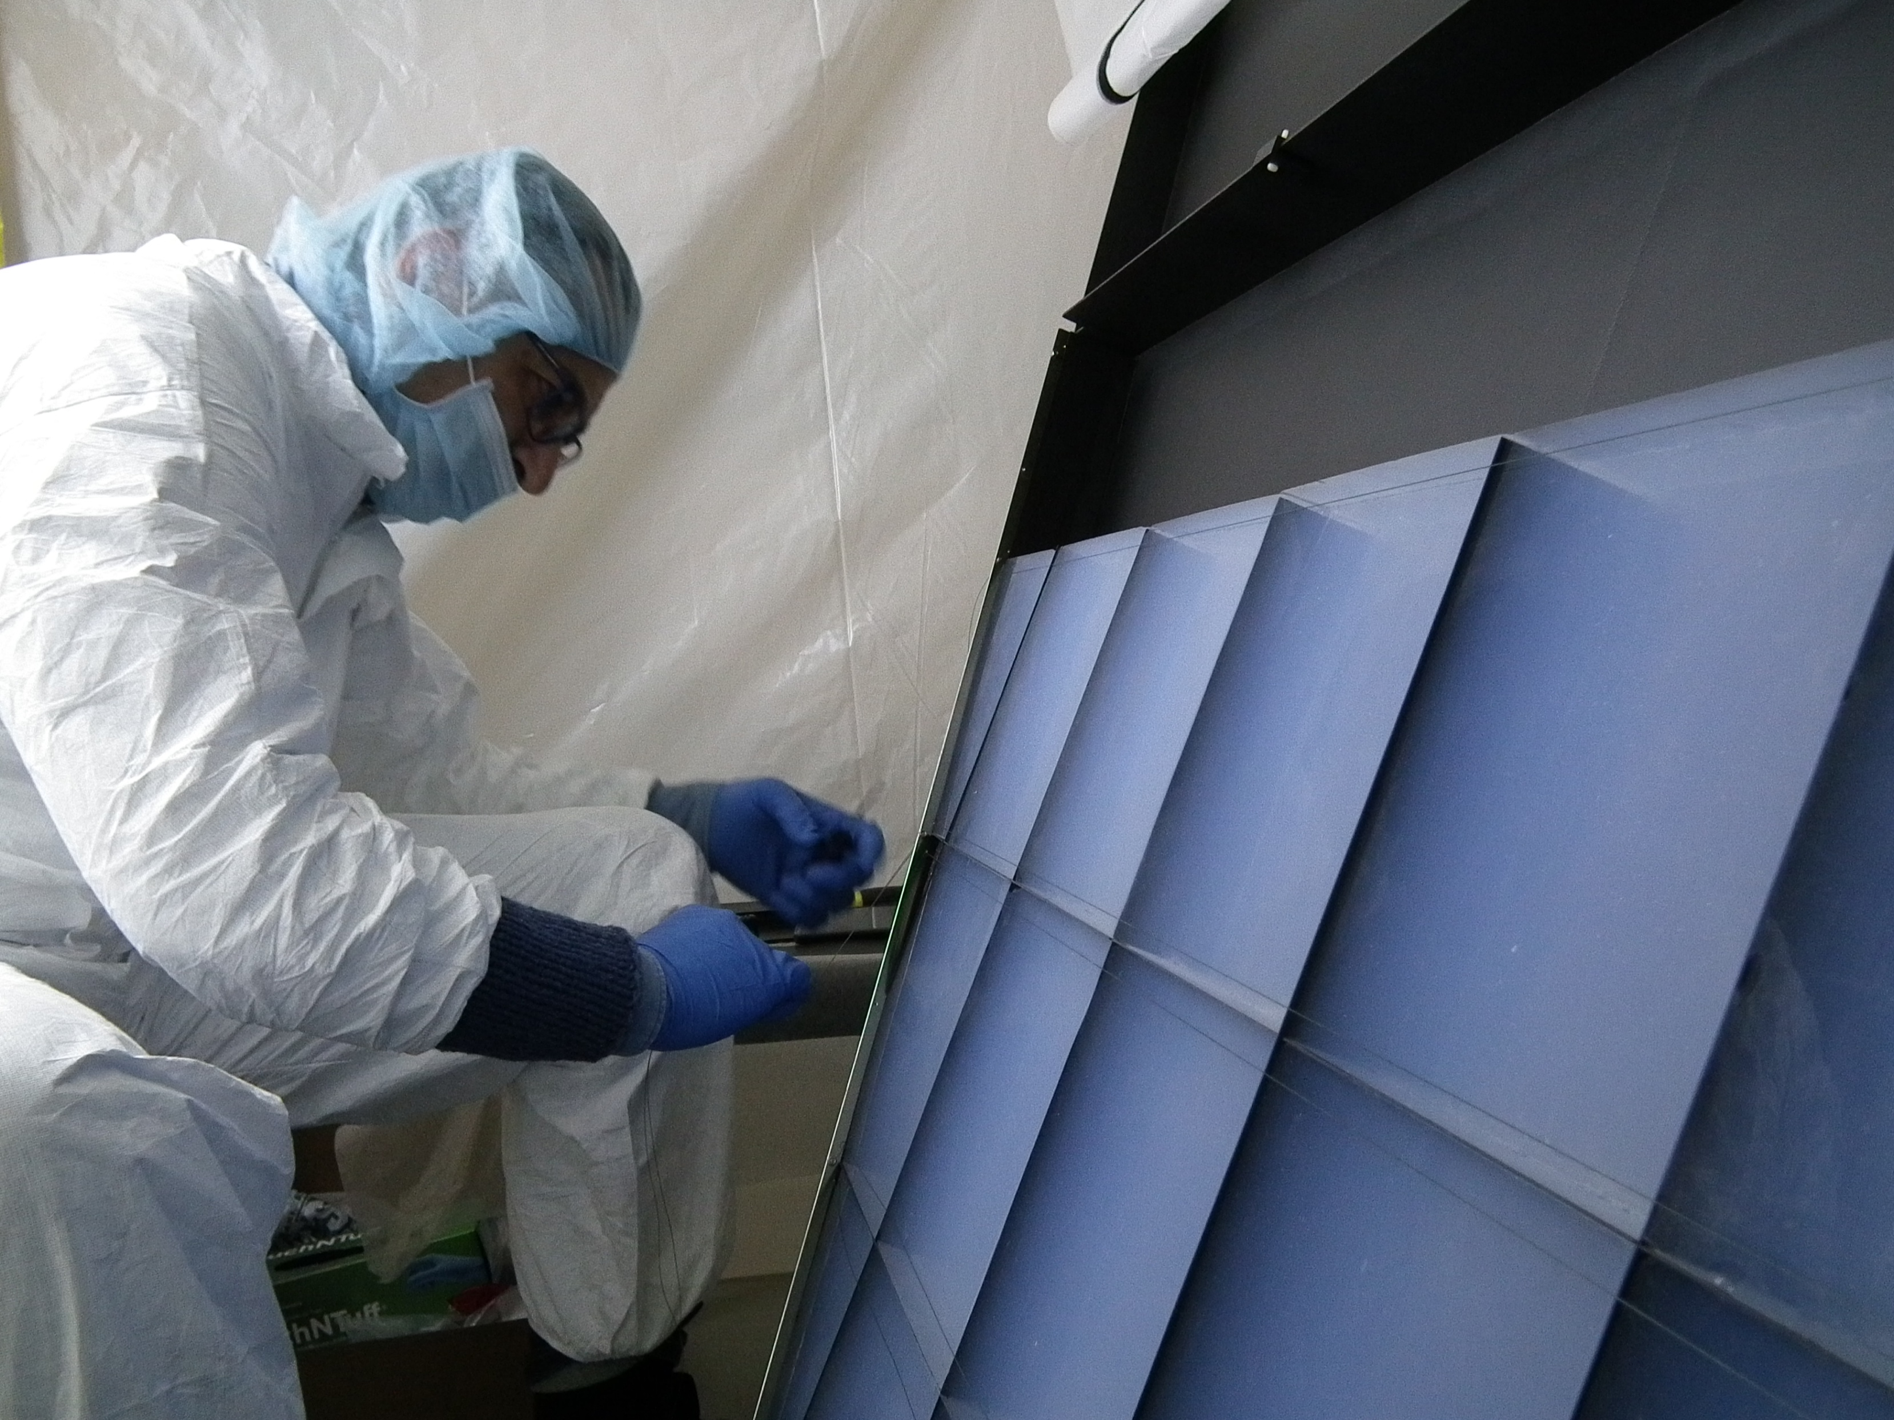
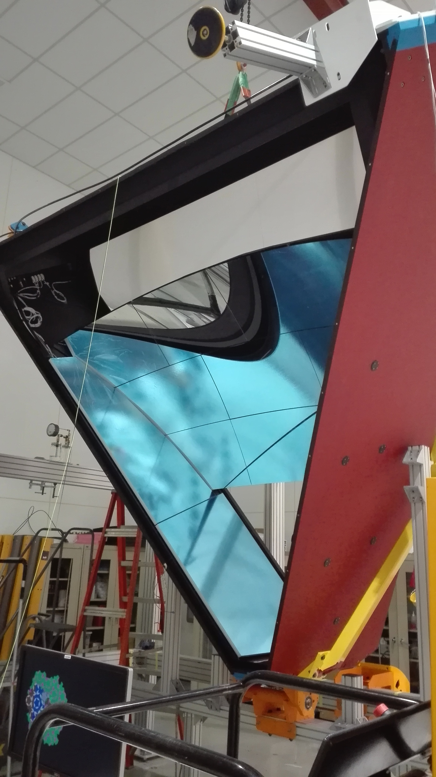
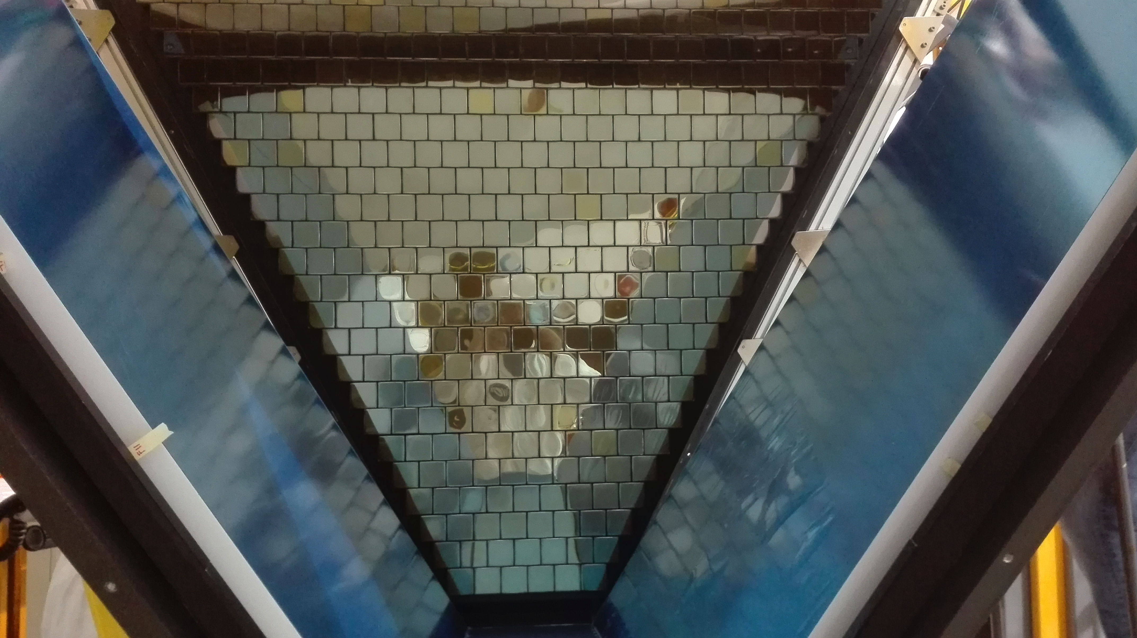
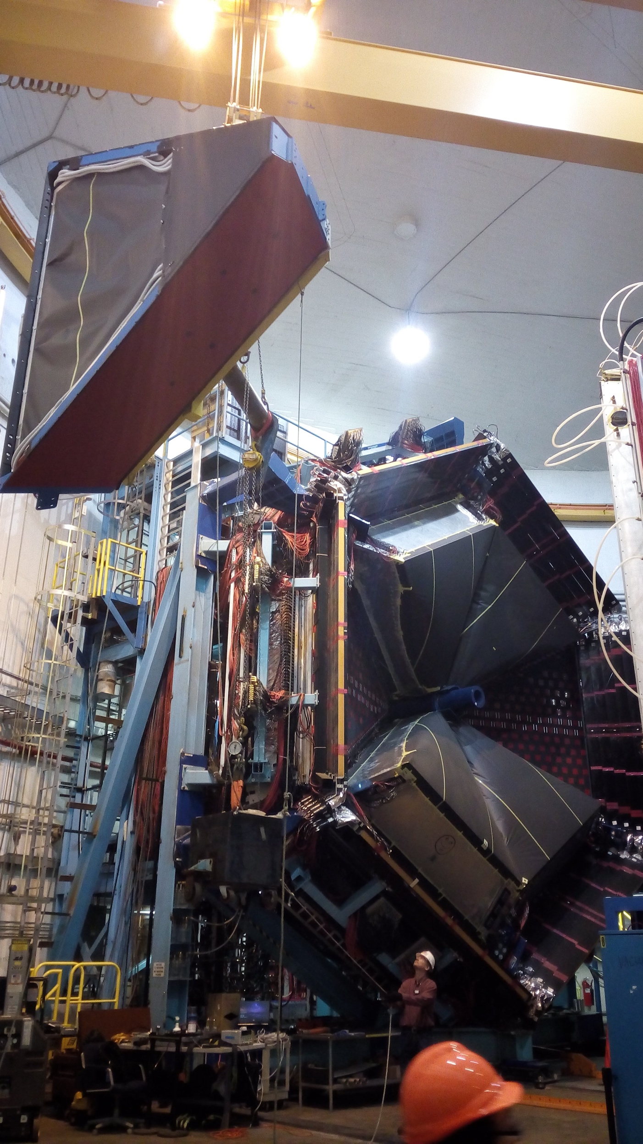
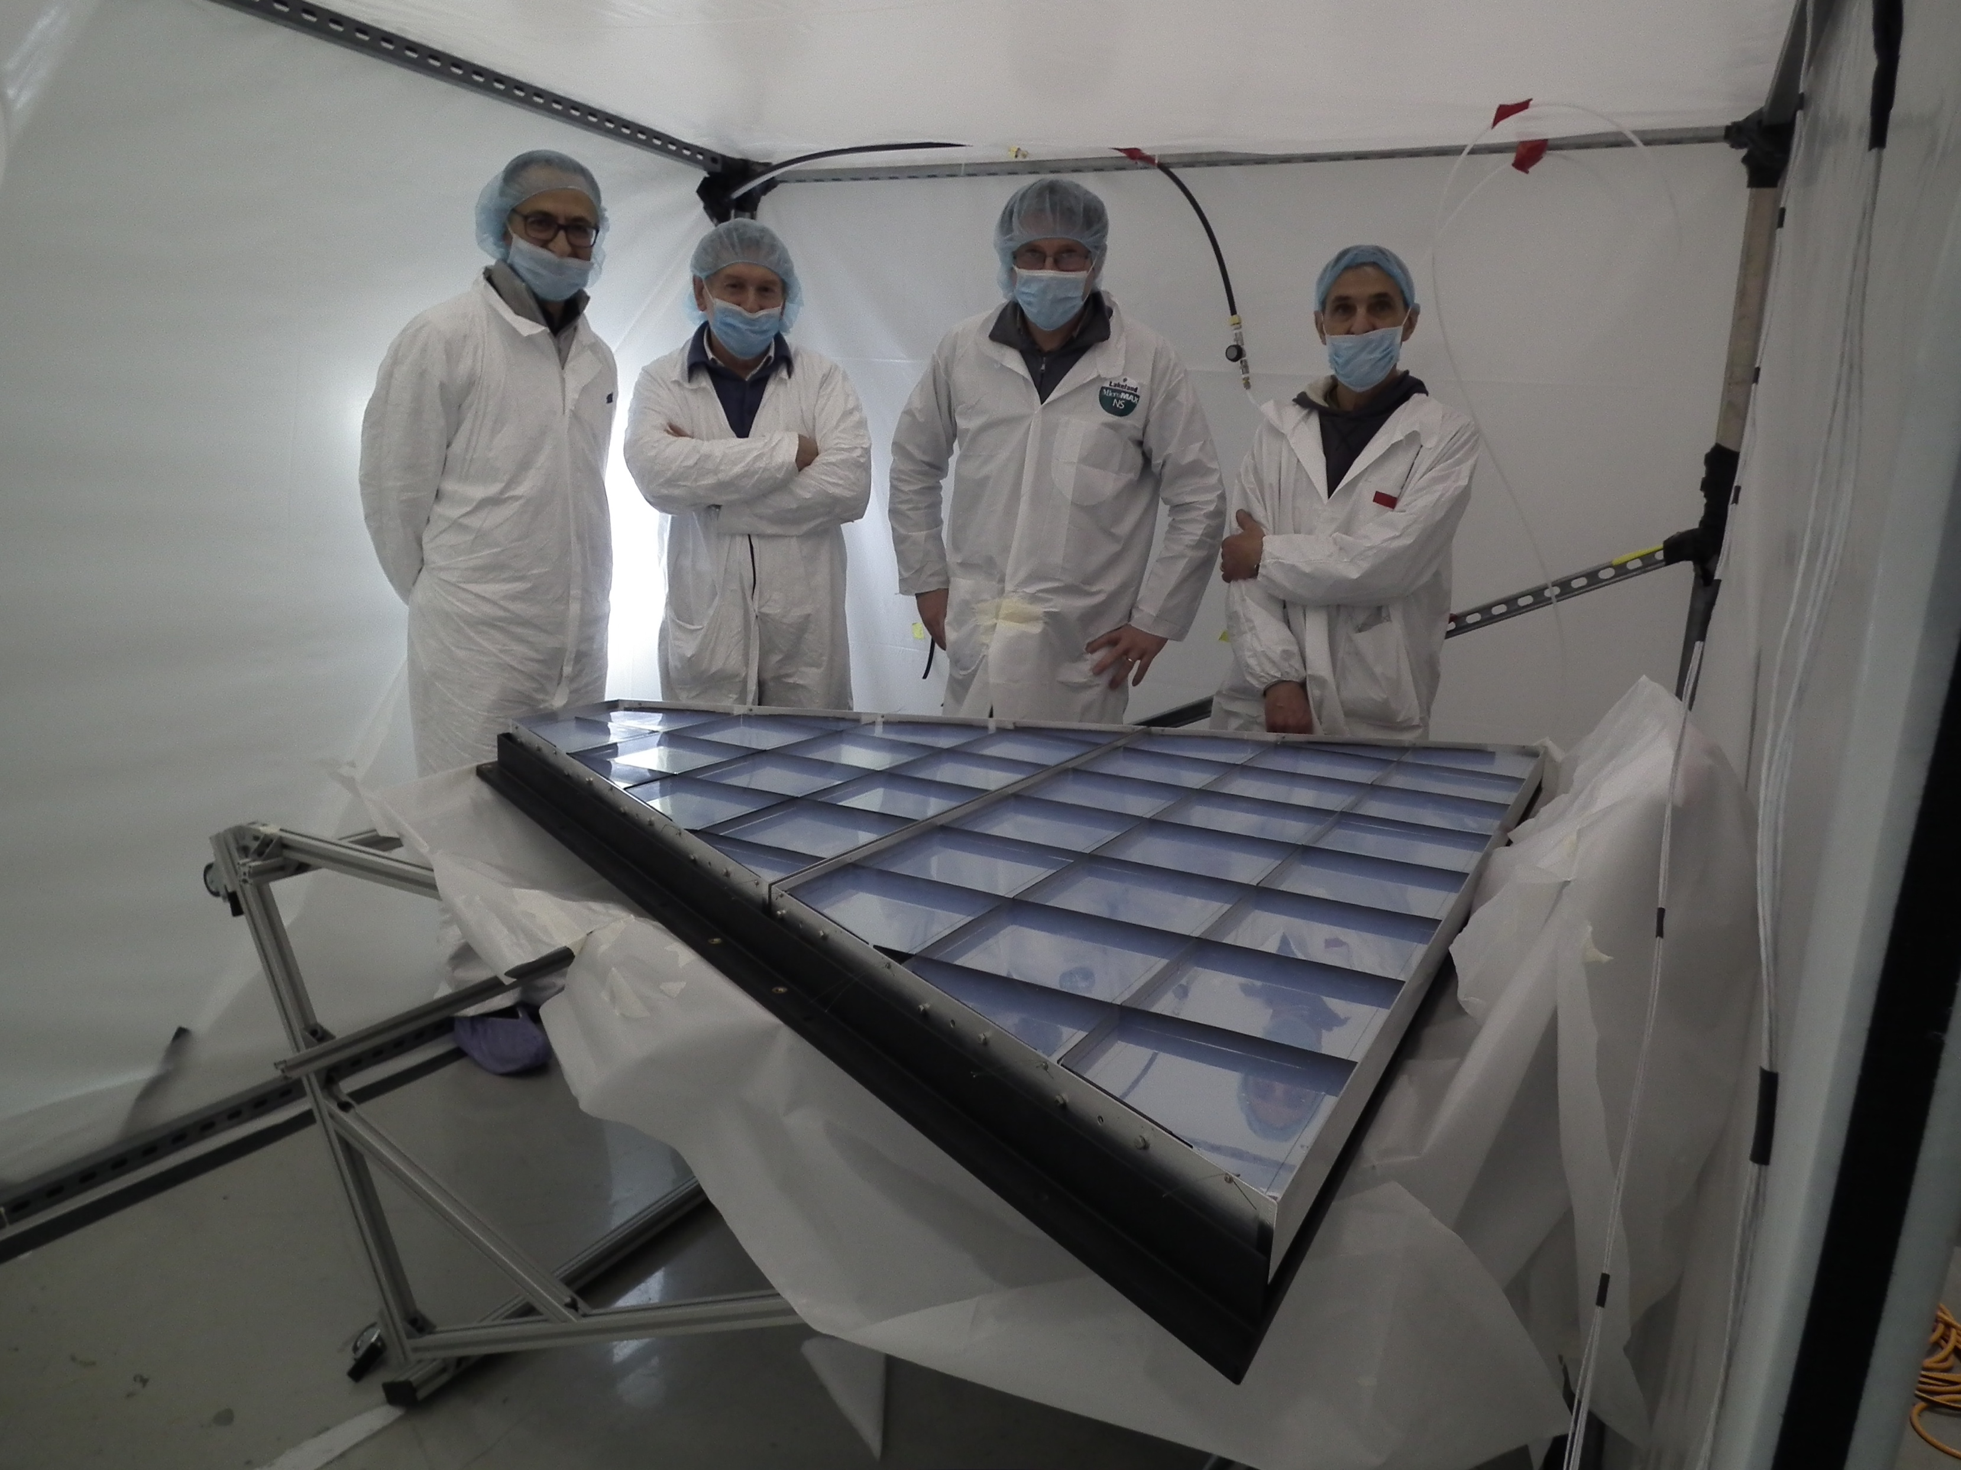
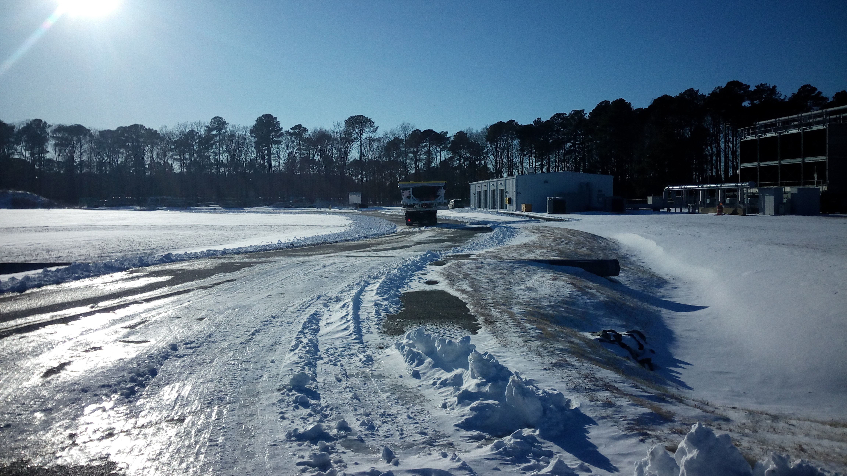
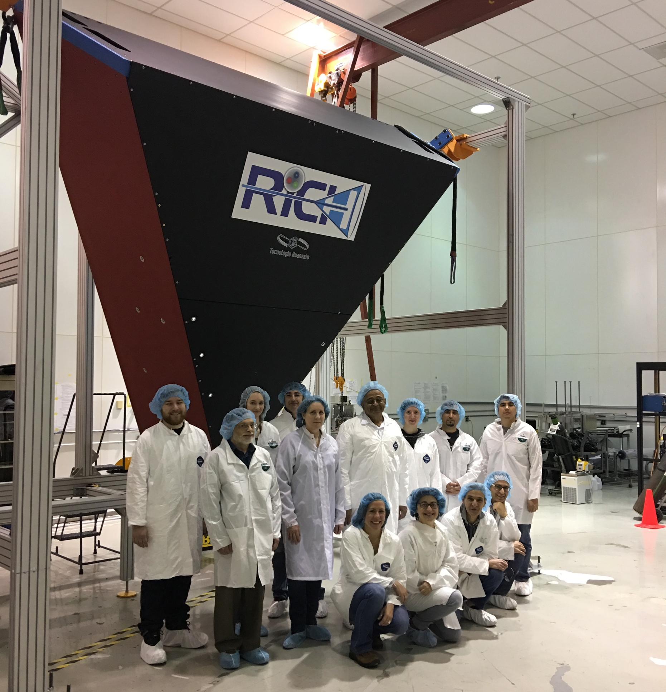
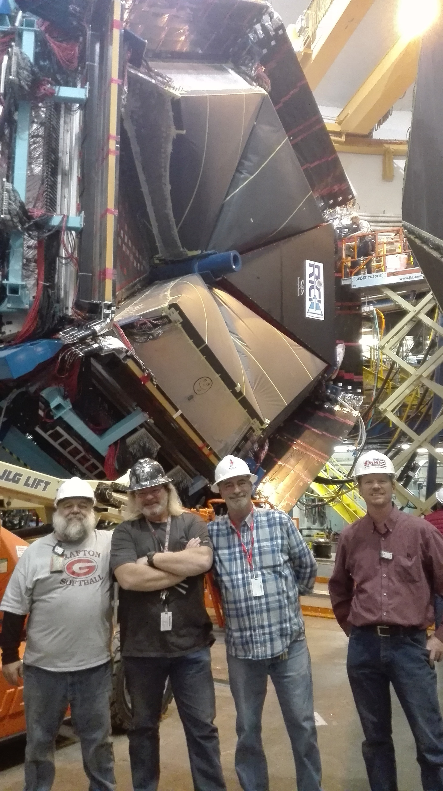
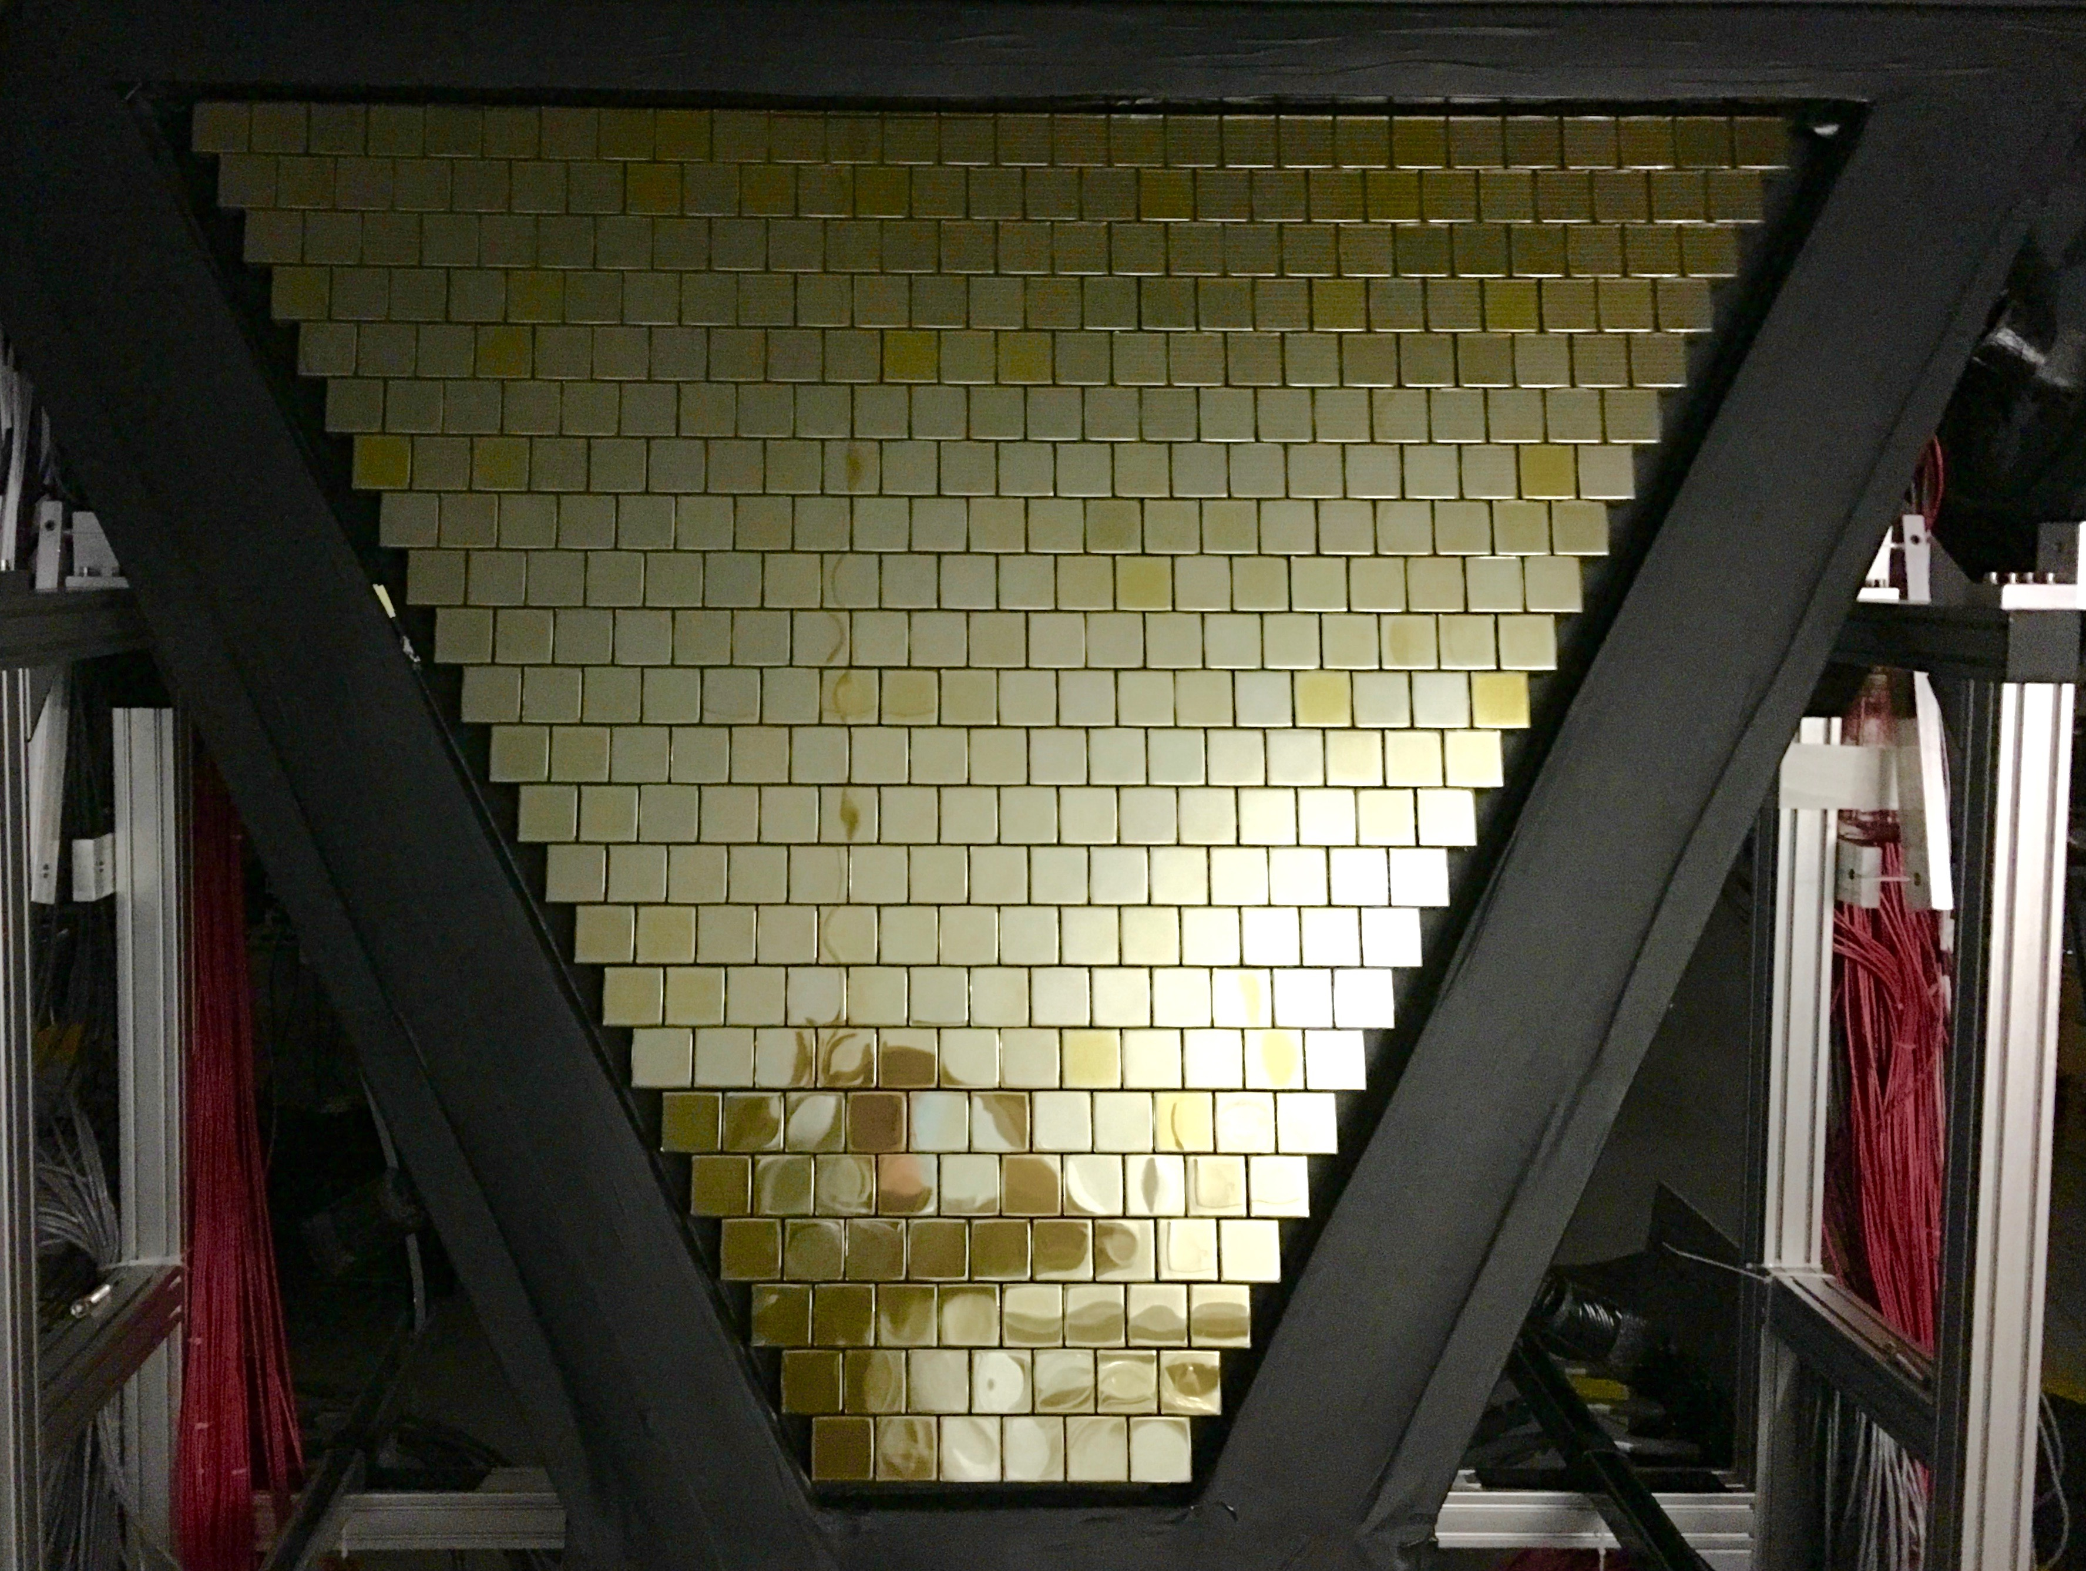
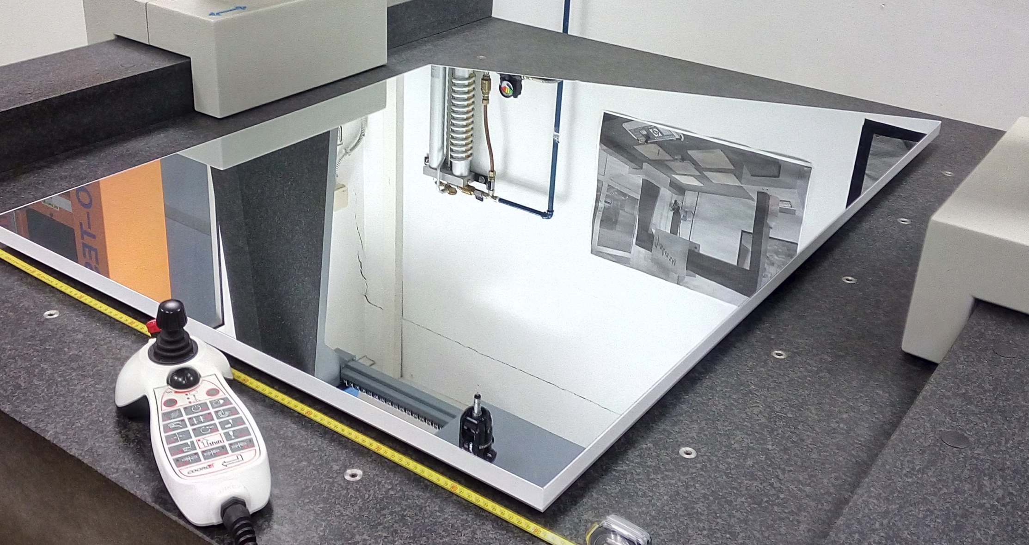
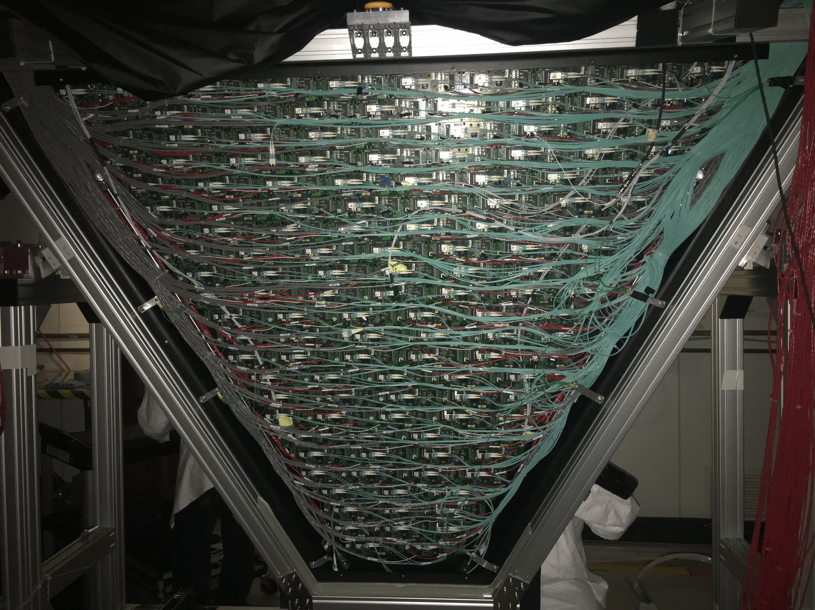
Ring Imaging
Cherenkov (RICH)
Thomas Jefferson National Accelerator Facility
What is it?
RICH In Action
The Ring Imaging Cherenkov Counter is used to:
Discriminate between pions, kaons and protons
When electrons pass through the RICH aerogel they are going faster than light does inside the aerogel. Consequently, they emit light. This effect (named after Cherenkov) is similar to the sonic boom of planes when they accelerate to a speed faster than the speed of sound.
Such light wave is detected in the forms of rings, the smaller the radius the larger the particle’s momentum. By combining the momentum and the ring radius we can determine if a particle is a pion, a kaon or a proton.
Left: a representation of a single track in RICH taken in April 2018. We collect about 10000 of these events every second.
Right: computer simulation of direct ring and reflected arcs onto the photo-sensors for pions, kaons and protons. Our software algorithms reconstruct each particle’s radius and can determine the particle type starting from the few detected photons (red stars).
Our computer simulation of one kaon (yellow line) producing Cherenkov light inside RICH. The white lines are photons produced in the aerogel and detected by the photo-sensors on the left
Is it an UFO? A secret plane being developed in Area 51?
Tech Specs
Aerogel refractive index: 1.05
Efficiency: 99.8% π/K rejection factor.
Photodetector: 64 channels photomulpliers
Number of photo-sensors: 391
Total number of channels: 25024
Data transfer: Fiber Optics.
Spherical mirrors:
Radius: 2.7 m or 9 feet
Area: 3.38 m² or 36 sqft.
Flat mirrors: Glass and Aluminum honeycomb
Two photo-sensors, each 64 pixels.
Monitoring suite used to check the hardware status of the RICH. Top left: all channels are healthy. Right: all photo-sensor are aligned to give the same response to the same amount of light. This calibration ensures we maximize the precision of our measurements.
Real time monitor of RICH. The photo-sensors run at about 1000 Volts (as a reference, household voltage is 120 Volts). All channels healthy!
Building and Installing RICH
Did you know?
Each RICH photo-sensor is a matrix of 64 pixels, each capable of detecting a single photon. As a reference, in normal light conditions our eyes receive about 200 million photons every second. RICH has 391 of these photosensors, for a total of 25,024 pixels.
There are 10 spherical mirrors, 4 lateral and four frontal and one bottom mirrors for a total mirror coverage of 10.3 m² or 111 sqft.
Best in class: Aerogel is a quartz foam, the only material with refractive index between gases and liquids. The RICH aerogel features unprecedented transparency and size at n=1.05.
Best in class: first use of glass-skin (0.7 mm) mirrors in particle physics experiments, with a cost one order of magnitude lower than standard composite materials.
About 18 photons are expected for a fully detected direct Cherenkov ring
Sandro Tomassini installing the aerogel tiles. Careful, each one costs $3,000!
The last picture of the inside of RICH before covering it up and make it 100% light tight: not even one single photon from daylight is getting inside the box.
Sandro Tomassini, Vincenzo Lucherini. Marco Contalbrigo, Dario Orecchini and the aerogel frame.
All RICH mirrors installed in the frame.
It was a snowing, gorgeous Virginia morning when RICH was transported to Hall-B.
Hall-B engineering leader Bob Miller overseeing the RICH installation. Like putting back a piece of a pie… very carefully…
One of the RICH mirrors.
We cannot really “see” the differences between this and conventional mirrors, even though the RICH mirror will look flawless.
The real contrast is in the reflectivity of high energy photons: invisible to the human eyes, these are not reflected by conventional mirrors. Only advanced chemical recipes can make mirrors capable of reflecting ultra-violet photons. The company that made the RICH mirrors kept the recipe a secret. You know, like Coca Cola.
Contributing Institutions
Jefferson Lab, Newport News, VA, USA
Istituto Nazionale di Fisica Nucleare, Italy.
Jefferson Lab Detector Support Group and INFN collaborators in front of the assembled RICH shell, March 2017.
Calvin Mealer, Denny Insley, Dough Tilles and Bob Miller. Newport News: RICH is installed.
Top: front view and Bottom: back view. All RICH photo-sensors, some 25,024 pixels, connected to electronics.

